Slide 1
Three Levels of ML Software
Pravin Y Pawar
Extracted from
An Overview of the End-to-End Machine Learning Workflow

Slide 2
Three levels of ML Software
ML/AI is rapidly adopted by new applications and industries!
Goal of a machine learning project is to build a statistical model by using collected data and applying machine learning algorithms
Yet building successful ML-based software projects is still difficult!
Every ML-based software needs to manage three main assets:
Data
Model
and Code
Essential technical methodologies - involved in the development of the Machine Learning-based software
Data Engineering: data acquisition & data preparation,
ML Model Engineering: ML model training & serving, and
Code Engineering : integrating ML model into the final product

Slide 3
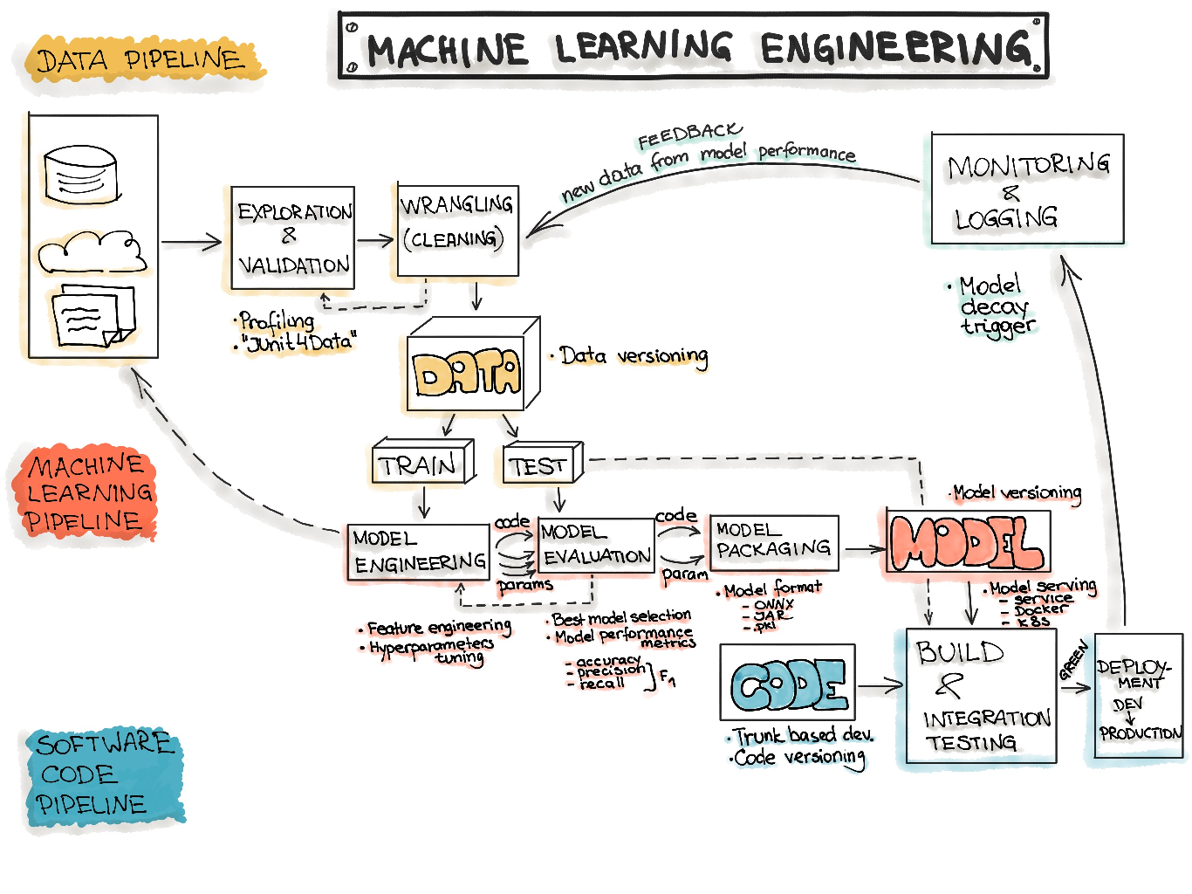
Machine Learning Engineering

Slide 4
Data Engineering
The initial step in any data science workflow is to acquire and prepare the data to be analyzed
Typically, data is being integrated from various resources and has different formats
Data Preparation
according to Gartner “an iterative and agile process for exploring, combining, cleaning and transforming raw data into curated datasets for data integration, data science, data discovery and analytics/business intelligence (BI) use cases”.
is reported to be the most expensive with respect to resources and time
Data preparation is a critical activity in the data science workflow
important to avoid the propagation of data errors to the next phase, data analysis
would result in the derivation of wrong insights from the data

Slide 5
Data Engineering(2)
Sequence of operations on the data leading to training and testing datasets for ML algorithms
Data Ingestion
Collecting data by using various frameworks and formats, such as Spark, HDFS, CSV, etc
Might also include synthetic data generation or data enrichment.
Data Exploration
Includes data profiling to obtain information about the content and structure of the data
The output of this step is a set of metadata, such as max, min, avg of values
Data Validation
Operations are user-defined error detection functions, which scan the dataset in order to spot some errors
Data Wrangling (Cleaning)
The process of re-formatting particular attributes and correcting errors in data, such as missing values imputation
Data Labeling
The operation of the Data Engineering pipeline, where each data point is assigned to a specific category
Data Splitting
Splitting the data into training, validation, and test datasets to be used during the core machine learning stages to produce the ML model

Slide 6
Model Engineering
The core of the ML workflow
Phase of writing and executing machine learning algorithms to obtain an ML model
The Model Engineering pipeline includes a number of operations that lead to a final model:
Model Training
The process of applying the machine learning algorithm on training data to train an ML model
includes feature engineering and the hyperparameter tuning for the model training activity
Model Evaluation
Validating the trained model to ensure it meets original codified objectives before serving the ML model in production to the end-user
Model Testing
Performing the final “Model Acceptance Test” by using the hold backtest dataset
Model Packaging
The process of exporting the final ML model into a specific format (e.g. PMML, PFA, or ONNX)
which describes the model, in order to be consumed by the business application

Slide 7
Model Deployment
Need to deploy model as part of a business application such as a mobile or desktop application
The ML models require various data points (feature vector) to produce predictions
The final stage of the ML workflow is the integration of the previously engineered ML model into existing software
Includes the following operations:
Model Serving
The process of addressing the ML model artifact in a production environment
Model Performance Monitoring
The process of observing the ML model performance based on live and previously unseen data, such as prediction or recommendation
interested in ML-specific signals, such as prediction deviation from previous model performance
signals might be used as triggers for model re-training
Model Performance Logging
Every inference request results in the log-record

Slide 8
Thank You!
In our next session:

